Slide 1

1914-1918
https://www.youtube.com/watch?v=NF3u8Ju9aAg

Slide 2
Who’s To Blame?
Germany was blamed…BUT
Many countries actually share the responsibility.
Austria, Serbia, Germany, France, Russia…

Slide 3
The Four Underlying Causes of WWI
M ~ Militarism
A ~ Alliance Systems
I ~ Imperialism
N ~ Nationalism
https://www.youtube.com/watch?v=SLj5r2nZHB8

Slide 4
Alliances
Triple Alliance
  Germany
  Austria-Hungary
  Italy
Triple Entente
  France
  Russia
  Great Britain

Slide 5
World War II:

Slide 6
World War II (1939–1945) Axis powers (Germany, Italy, Japan, Hungary, Romania, Bulgaria) versus Allies (U.S., Britain, France, USSR, Australia, Belgium, Brazil, Canada, China, Denmark, Greece, Netherlands, New Zealand, Norway, Poland, South Africa, Yugoslavia).

Slide 7
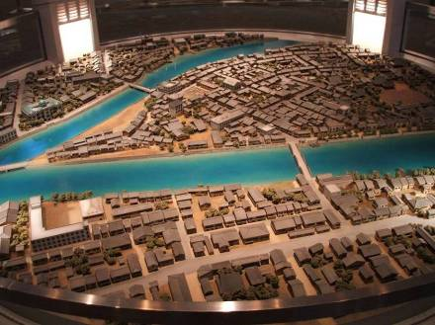
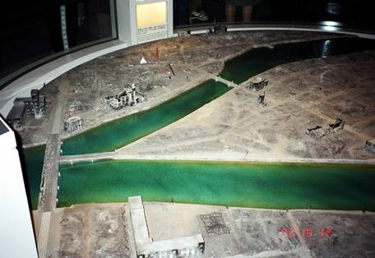
End of WWII: Hiroshima
Hiroshima Model Before Bombing
Hiroshima Model After Bombing

Slide 8
End of WWII: The Rise of Superpowers
At the end of the war, there emerged two clear Superpowers: The United States of America and the Soviet Union .
A superpower is a country that has the highest level of influence on world politics and has a very strong military.
Although the USA and Soviet Union were friends during WWII, after the war they are enemies.

Slide 9
End of WWII: Beginnings of the Cold War
The debate over the division of Germany would be the first of many problems between the Soviets and the U.S.A.
Following the war, the Soviets also developed an atomic bomb.
Now the two world superpowers both have nuclear weapons.

Slide 10
Cold War: Politics
Communism is an economic system and form of government in which the government makes all of the decisions as to what will be produced, how it will be produced, and for whom it will be produced.
Capitalism is an economic system in which individuals decide what to produce, how to produce, and for whom to produce.
Democracy is a form of government in which the people control the government by voting.

Slide 11
DECOLONIZATION
After World War II, dramatic changes swept across the world. After the fight against dictatorship, many leaders argued that no country should control another nation. People of colonized regions started to gain independence as Asia and Africa became decolonized.
The first colonized nation to gain its independence was India. Britain had ruled India for almost 200 years, but Britain’s weakness after WWII created opportunities for Indian freedom. Mohandas Gandhi used nonviolence and boycotts to help India become independent in 1947.

Slide 12
Origin of UNITED NATIONS
In 1945, 48 nations formed the United Nations (UN), whose headquarters are in New York City. The UN serves to protect international peace and equal rights.
The UN has a General Assembly where each member nation can cast its vote on a broad range of issues. But the real power is in the Security Council led by five permanent members: Britain, China, France, the United States, and Soviet Union. Each could veto any Security Council action.

Slide 13
CRISIS AND SOLUTION in 21st Century……
        For a sustainable society
        Better WORLD

